Slide 1


Open Source Collaboration for Comparing analysis method implementations in software (CAMIS)
Harshal Khanolkar
Novo Nordisk Global Business Services
Notes:
Thank you for joining this session which will give an introduction to the PHUSE / PSI / R Consortium collaboration project “CAMIS”.
The QR code on screen will take you to the website for more information and I’ll put it up again at the end of the presentation.

Slide 2
Disclaimer
The views and opinions expressed in this presentation are the views, thoughts, and opinions belonging solely to the presenter, and not necessarily to the presenter’s employer/organization/committee/other groups or individual.
No data or confidential information belonging to Novo Nordisk has been used in this presentation.

Slide 3
Let’s meet Statisticians from Project A123
Statistician X
Learnt minitab, GLIM, MATLAB, SAS, SPSS, &
S-PLUS at university. Heard of R – but lack of validation scares him
10+ years later SAS programming at a CRO
Statistician Y
Learnt R, python, matlab and SPSS at university
Graduated 2022 and started a job at a Contract Research Organization (CRO)

Slide 4
Project A123 – Assignment – Year 2022
Kaplan-Meier plots of Overall Survival will be presented by treatment group.
Overall survival will be analyzed using a stratified log-rank test with hazard ratio and 95% CI from the cox-proportional hazards model
Client is software agnostic but needs the analysis today !
Statisticians X & Y are assigned to do the development & independent QC
Statistician X decides to use SAS
Statistician Y decides to use R
Notes:
The year is 2022:
A project gets assigned to X & Y to program and QC independently.
It’s a really simple analysis of Overall survival using Kaplan meier estimates, cox proportional hazards modelling and a log-rank test.
Kaplan-Meier plots of Overall Survival will be presented by treatment group.
Overall survival will be analyzed using a stratified log-rank test with hazard ratio and 95% CI from the cox-proportional hazards model
Client is software agnostic but needs the analysis today !
X’s done these 1000’s of times before in SAS, expects to be home on time tonight.
Y’s never done this in SAS before, but has used R on his university course, so decides it will be quicker for him to use R to do the work.

Slide 5
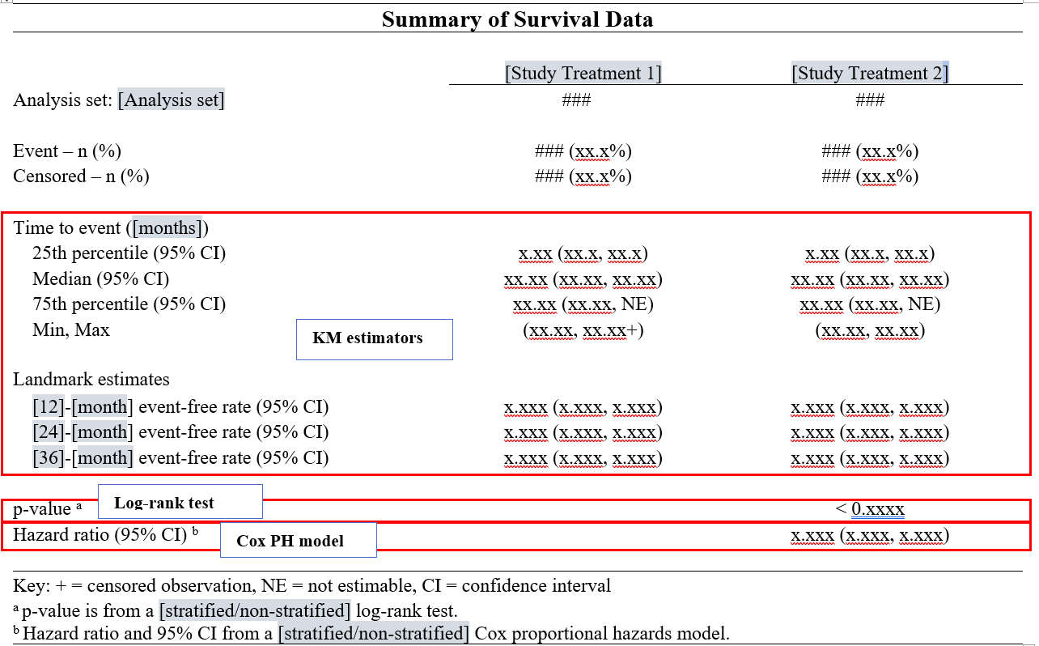
Project A123 – Mock Shell
Notes:
Here is the shell they’ve been provided with.

Slide 6
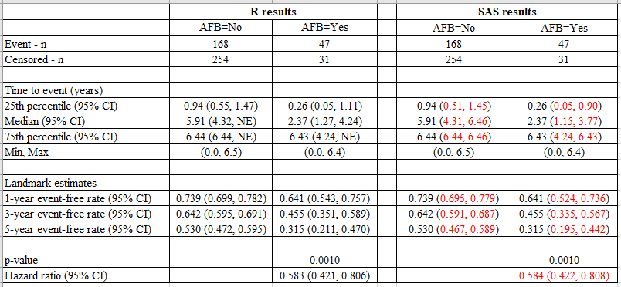
Project A123 – Results – R vs. SAS
Notes:
X & Y output a dataset containing the results, but some do not agree?
They compare input datasets – which are identical so the discrepancy must be because R & SAS are doing something differently?
But
Which is correct?
Who needs to change their code & how?
What do they do now?

Slide 7

Project A123 – Year 2022 – Panic !!!
Notes:
In the year 2022… this may lead to a Panic and a lot of stress.
Considerable investigation of the documentation supporting the R package that Y is using would be needed. This would then need comparing to the SAS manuals/website to try to determine why the differences exist.
It could lead to missing the deadline required by the client.

Slide 8

Project A123 – Year 2023
Notes:
However, lets fast forward to 2023 !!
X & Y Access the CAMIS website.
They consult the CAMIS repository Survival analysis pages, they find the problem is already documented there and hence know what to do to fix the discrepancy.
The issue is resolved & they both leave work early, having delivered a high quality package to the client.
So what is CAMIS, How it helps user, what can you do to support?

Slide 9
Welcome to the CAMIS repository !!!
CAMIS: Comparing Analysis Method Implementations in Software
A cross-industry collaboration formed by members of statistical and programming associations such as PHUSE, PSI, R Consortium and ASA.
Goal -:
To create a white paper
To create a Github repository to store programs related to statistical methods from various softwares and document any differences observed in the results obtained.
Notes:
CAMIS stands for: Comparing Analysis Method Implementations in Software
This is a cross-industry collaboration formed of members statistical and programming associations such as PHUSE, PSI, IASCT and ASA. Anyone can be a contributor.
We have 2 Aims:
1) To create a white paper
2) To create a github repository to store how to apply statistical methods in various software and document any differences observed in the results obtained

Slide 10
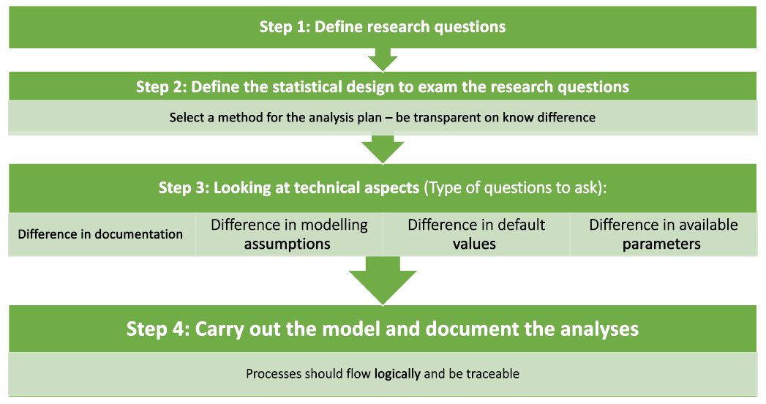
CAMIS White Paper
Notes:
The white paper describes a 4 point process to ensure analysis is clearly specified such that it isn’t dependent on software default settings which can change across software
Define the research question – often in the protocol
Define the statistical design to examine the research questions. Select a method for the analysis plan and be transparent on any known differences which approach you are taking
Look at the technical aspects a) differences in software documentation for which methods are being used (convergence algorithms etc), 2) any modelling assumption differences, 3)any default values used by software? 4) any differences in the available parameters.
Carry out the pre-specified analysis and display the results.

Slide 11
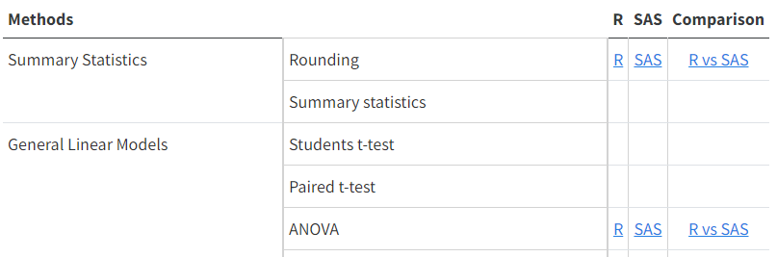
The CAMIS repository
Repository Weblink - https://psiaims.github.io/CAMIS/
For the method that is currently completed, the repository contains
Analysis in R
Analysis in SAS
Comparison between software results / noting differences
We hope to expand to include Python, Julia and/or other software
Notes:
The repository is now LIVE and we are building up examples of the methods applied in R, SAS and documenting any differences between how the software performs the statistical method.
NOTE: we hope to expand to include Python, Julia & other software in the future.
When you get to the CAMIS home page, you will see a Table of methods. If a link exists then we have already created documentation for that method.
If no link exists and you have content you would like to add then please get in touch with us.

Slide 12
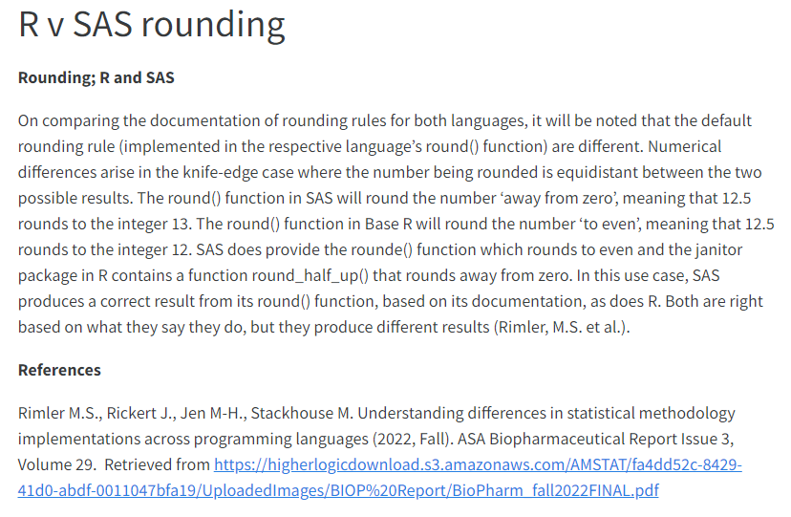
The CAMIS repository – Example of Rounding Function
Number to round | Round() in R, or Rounde() in SAS | Round() in SAS or janitor package [round_half_up() in R]
1.2345 | 1.234 | 1.235
Notes:
For example….lets take the simple case of rounding…
The round() function in Base R will round to the nearest whole number and ‘rounding to the even number’ when equidistant, meaning that exactly 12.5 rounds to the integer 12.
This can be replicated in SAS using the rounde() option is SAS, but the more standard/default option in SAS is to use round()
The round() function in SAS will round to the nearest whole number and ‘away from zero’ or ‘rounding up’ when equidistant meaning that exactly 12.5 rounds to the integer 13.
The table shows where this rounding difference between SAS & R could be the source of obtaining different results.
Both SAS and R can have their defaults change to produce the same results.

Slide 13



The CAMIS - Call for Action – How you can support?
Documenting how to perform statistical methods in R, SAS & comparing them
Adding to the repository differences between R & SAS that know about
You can be a contributor or JOIN US on the PHUSE working group
Adding content for Python, Julia or other software
Review/ revision of existing CAMIS content.
Notes:
This presentation is a call for Action - so here is how you can help us to build a high quality comprehensive repository.
Would you be interested in documenting how to perform a statistical method in R, SAS and comparing them? Our github repo has a list of issues awaiting investigation. If you would like to contribute to a specific are then please get in touch to be assigned.
Do you already have some content that you would like to load to the site which documents some difference between the was SAS and R do statistical analysis. If so please get in touch and we can show you how to load to the site
Do you want to explore other software?
Are you a statistical expert and would like to review our content to ensure our methods and documented correctly. Then please review our existing CAMIS content and do a pull request to suggest changes/ corrections.
This is a community led effort so the more people we have contributing the more comprehensive the project can become.
You can be a contributor or join the PHUSE working group which meets monthly.

Slide 14
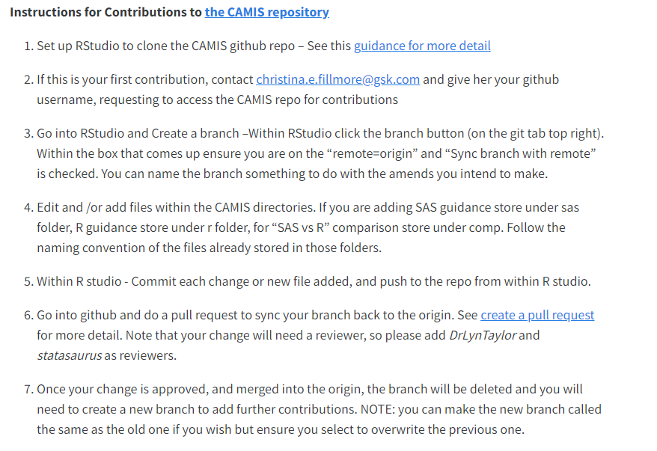
The CAMIS - How to Contribute?
Go to the Contribution tab on the website and follow these instructions
Notes:
For instructions of how to contribute please go to the contribute Tab on the website where step-by-step instructions exist.

Slide 15

The CAMIS - Contact us
psi.aims.r.validation@gmail.com
https://github.com/PSIAIMS/CAMIS/discussions
Notes:
For more information please check the website. For specific questions you can reach out to us at psi.aims.r.validation@gmail.com or at the github discussions tab: https://github.com/PSIAIMS/CAMIS/discussions

Slide 16
Thank You

